Slide 1

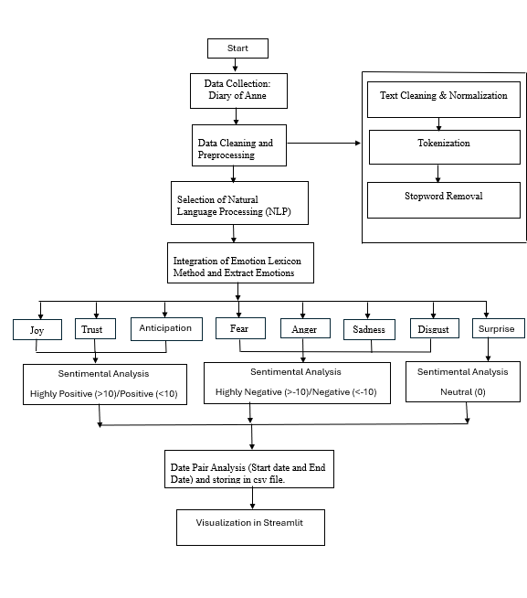
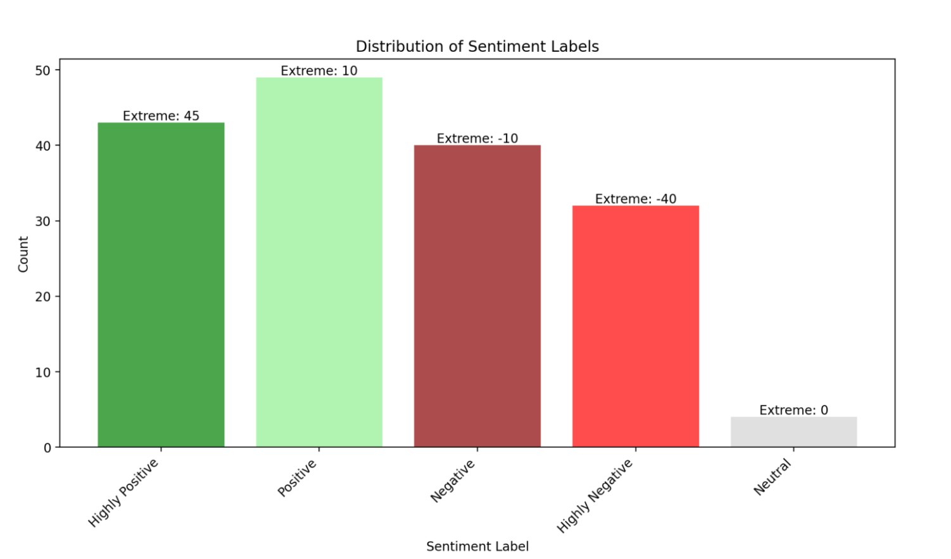
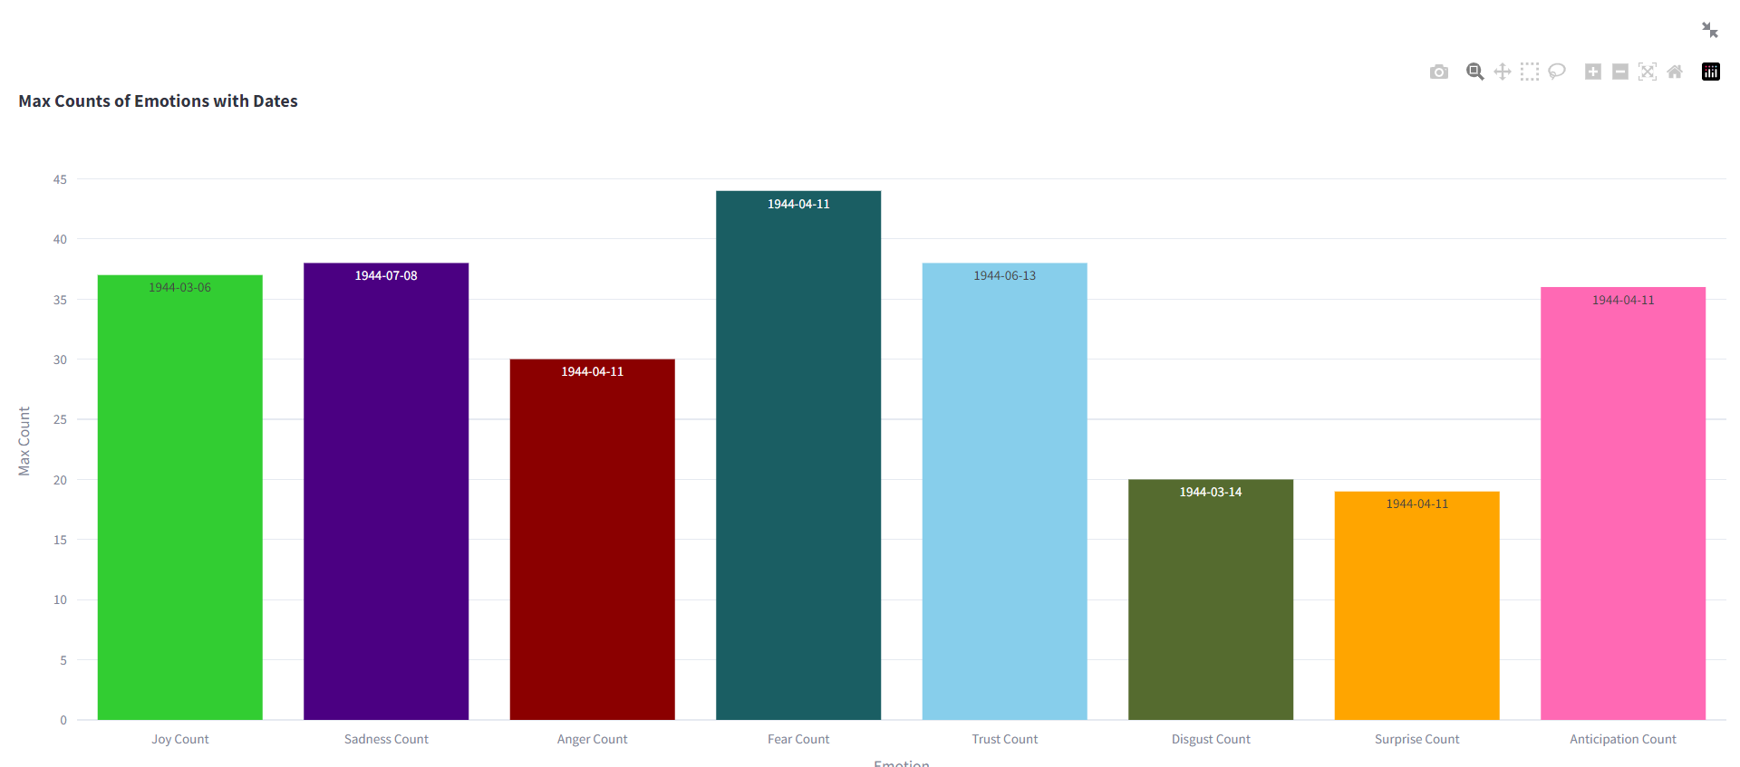
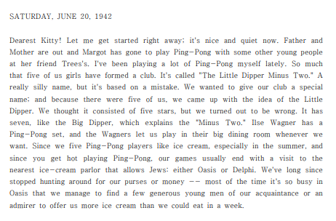
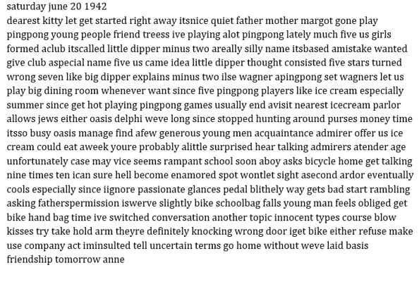

Sentiment Analysis of Cultural Heritage Texts:
Anne Frank Diary of Young Girl
By: Smita Sanjay Pable
Advisor: Christina Moir
Introduction
Flow Chart of Sentiment Analysis
Fig 3: Flow Chart of Sentimental Analysis of Historical text
Synthesis of historical texts by NLP, as shown in Anne Frank's diary, brings out amazing information about the history of mankind. Anne's diary, a witness to her emotional journey, revealed her inner conflict. NLP algorithms along with the NRC Emotion Lexicon help to elucidate Anne's inner emotions and Streamlit shows us her courage and pivotal moments. Apart from individual emotions, this research adduces the patterns of psychology that shape the course of historical events. Anne's transcendent strength is what is left that will contribute to the improvement of cultural traditions and development of cultural identity.
Visualization
Fig 4: Distribution of Sentiment Labels with Extreme Scores
Fig 5: Highest Count of Each Emotion with Date
Preprocessing and Data Cleaning
The text preprocessing stage focuses on eliminating unnecessary characters and symbols, removing non-linguistic content such as numbers, text tokenized into discrete words and filtering out stop words to facilitate meaningful analysis.
Results:
Fig 1: Before Data Preprocessing and Cleaning
Fig 2: After Data Preprocessing and Cleaning
Methodology for Sentiment Analysis and Emotion Extraction
Data Collection: Obtaining Anne's Frank's diary entries.
Text Preprocessing: Processing and formatting of text data for the analysis.
NRC Emotion Lexicon Loading: Loaded the NRC Emotion Lexicon in which the words are marked with the emotions and sentiments rating.
Sentiment Score Calculation and Labeling: The difference between the positive and negative emotions can be measured. Thus, this helps in calculating the sentiment scores and you can place them in clearly defined categories.
Date Pair Analysis: Pick the date-entries in the diary text to know the sentiments and emotions trends over time.
CSV Data Export: Save extracted emotions and sentiment scores along with the date entries in a CSV file for further analysis.
Visualizing the extracted data in Streamlit.
Conclusion
Examining Anne Frank's diary sentimentally brings out the way that a young girl was emotionally going through difficult times in history. By means of close reading and visualizing, we find her emotion changes from complete depression to little episodes of optimism. The study adds depth to our knowledge of Anne's survival and resilience and provides insights into the human experience amid genocide.
QR Code for Streamlit app & References

